Slide 1
Bank Customer Churn
MindX TC_DA19
Nguyễn Minh Phát

Slide 2
AGENDA
Introduction​
Exploratory Data Analysis (EDA)
​Data Processing
Model Training and Evaluation
Before Up-sampling Data
After Up-sampling Data
​Conclusion
References

Slide 3
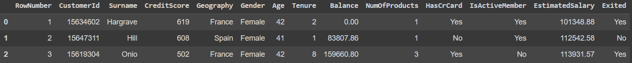
Introduction
The objective of the bank customer churn dataset is to predict whether customers will continue to use the bank's services or not.
The dataset has 14 columns, 10000 observations.
Predict

Slide 4
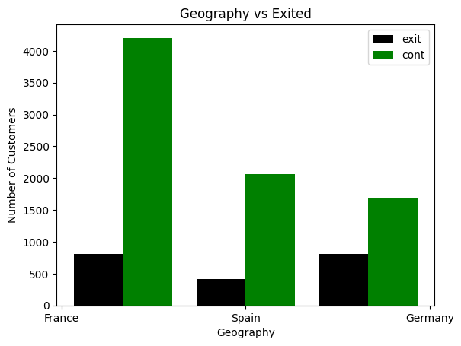
Exploratory data analysis
Geography: France , Spain, Germany
Most of the customers are from France
In Germany, the number of customers leaving accounts for the highest percentage

Slide 5
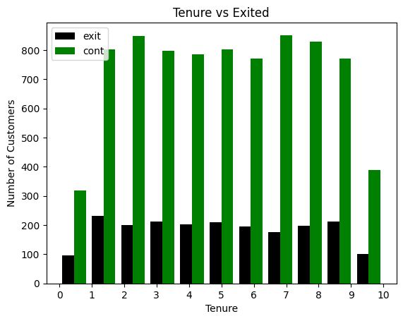
Exploratory data analysis
The majority of customer tenure in the data set is from 1 to 9 months.
The number of customers who stay with the term of 2 months and 7 months account for the most.

Slide 6
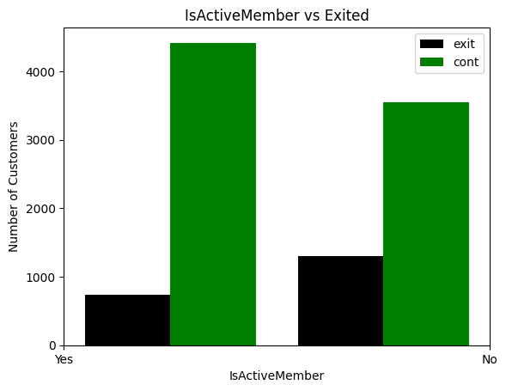
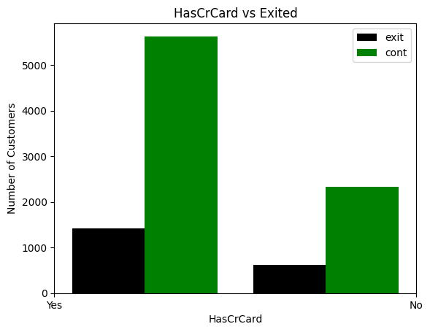
Exploratory data analysis
High
High

Slide 7
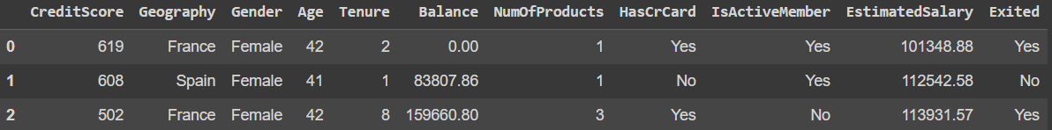
Data Processing
Drop columns
Result

Slide 8
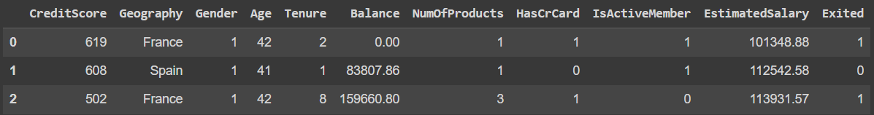
Data Processing
Replace Binary Values (Female = 1, Male = 0) (Yes = 1, No = 0)
Result

Slide 9
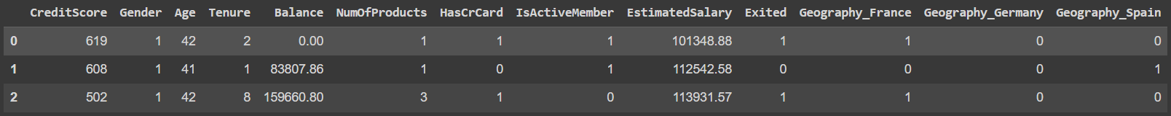
Data Processing
One-hot Encoding (get dummies)
Result

Slide 10
Data Processing
Scale columns to range(0, 1) (Min Max Scaler)
Result

Slide 11
Model training and evaluation

Slide 12
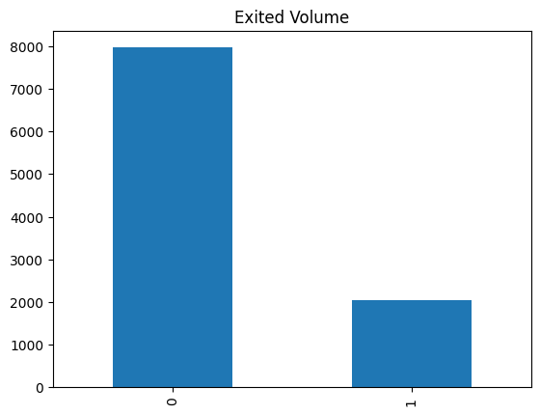
y
Churn dataset got Imbalanced data
➔ Up-sampling ???

Slide 13
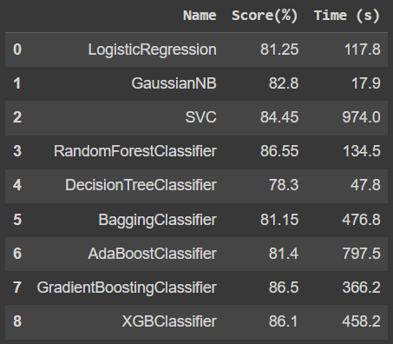
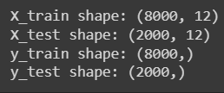
Model training – Before up-sampling
Models Score and Time Executing
Run some models with default hyperparameters
XGBoost and Random Forest model for following training
Input

Slide 14
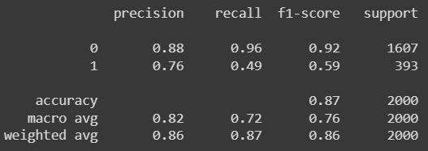
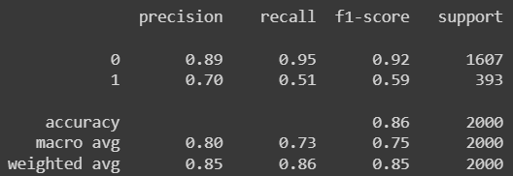
Model training – Before up-sampling
Random Forest
Low Score in Precision, Recall, F1-Score of 1
➔ Try Up-sampling data
XGBoost

Slide 15
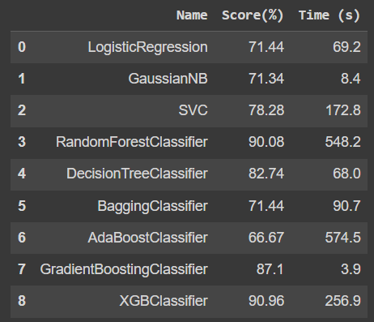

Model training – After up-sampling
Models Score and Time Executing
Run some models with default hyperparameters
Some models have increased score up to 90%
XGBoost and Random Forest model for following training
SMOTE
Input

Slide 16
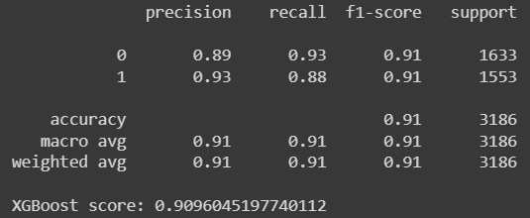
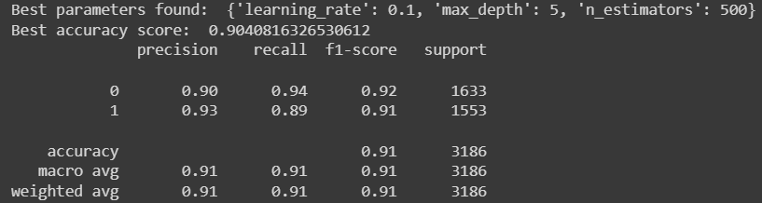

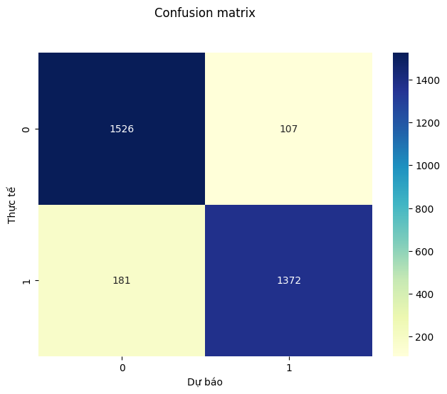

Model evaluation – after up-sampling
XGBoost - Default
XGBoost – Hyperparameter Tuning

Slide 17
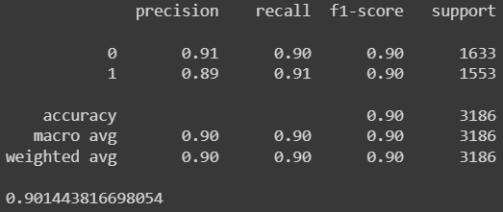
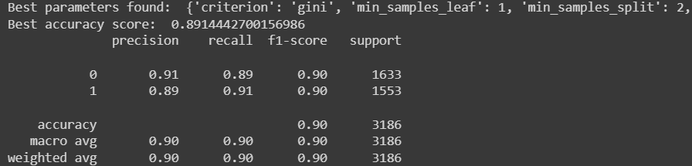
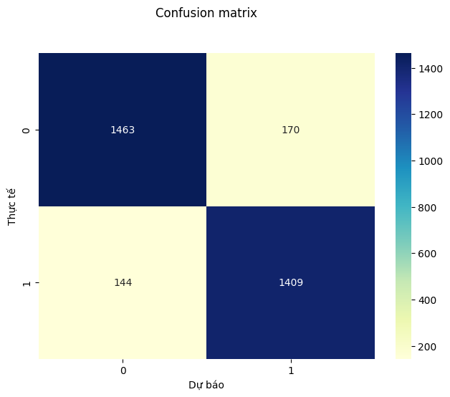

Model Evaluation – after up-sampling
Random Forest - Default
Random Forest – Hyperparameter Tuning

Slide 18
Model Evaluation – Final Judging
Random Forest - Default
XGBoost – Hyperparameter Tuning

Slide 19
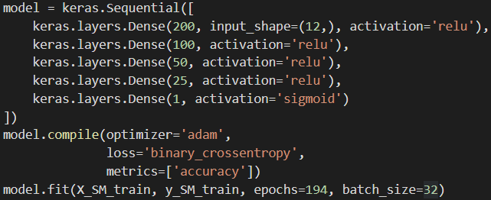
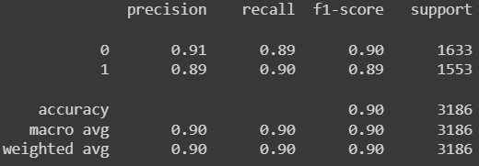

Option: Model training – Deep learning (Neural Network)
Models Configuration
Result
Score is lower than Tuned-XGBoost model ←

Slide 20
conclusion
Processing imbalanced data is important for classification tasks because it can improve the performance of the model by reducing the impact of the class imbalance on the training process.
XGBoost is a highly effective algorithm for classification problem.
Neural Network is a promising approach to work with complex dataset.

Slide 21
References
Dataset
https://www.kaggle.com/datasets/barelydedicated/bank-customer-churn-modeling
Youtube reference
https://www.youtube.com/watch?v=MSBY28IJ47U&ab_channel=codebasics
Chat-gpt

Slide 22
THANK YOU

